Slide 1

Week 4 – Symmetric Encryption I
CT5046 Cryptography and Security
University of Gloucestershire

Slide 2
Overview
Symmetric encryption
Block vs Stream Ciphers
Feistel Cipher
DES
Recap
PSS

Slide 3
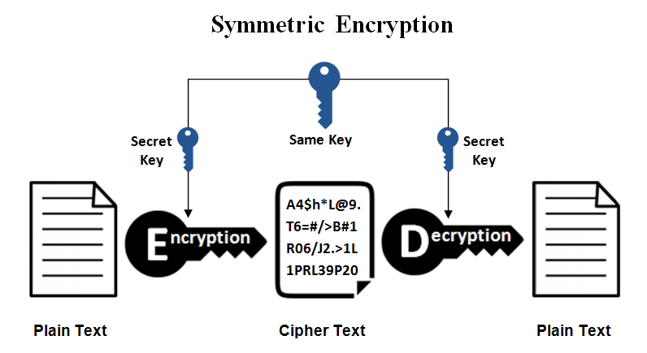
Overview of symmetric encryption

Slide 4
Examples
Stream ciphers
Encrypt a stream of plaintext one byte at a time
Performs XOR operation between each plaintext and key bits
E.g., Vernam cipher, Vigenere cipher
Block ciphers
Encrypt a block of plaintext at a time
Block size typically start at 64 bits
E.g., DES, AES

Slide 5
Feistel Cipher

Slide 6
Overview on Feistel cipher
Based on invertible product cipher
Input broken down into two halves
Based on round function of right half and subkey
Consists of multiple operations consisting of:
Performing substitution on the left half of data
Permutation operation through swapping halves

Slide 7
Shannon's Diffusion and Confusion
Based on the principle that a cryptography system must be resilient against statistical attacks
Diffusion
Making the relationship between the plaintext and the ciphertext as complex as possible
Achieved through permutation
Confusion
Making the relationship between the ciphertext and the encryption key as complex as possible
Achieved through substitution

Slide 8
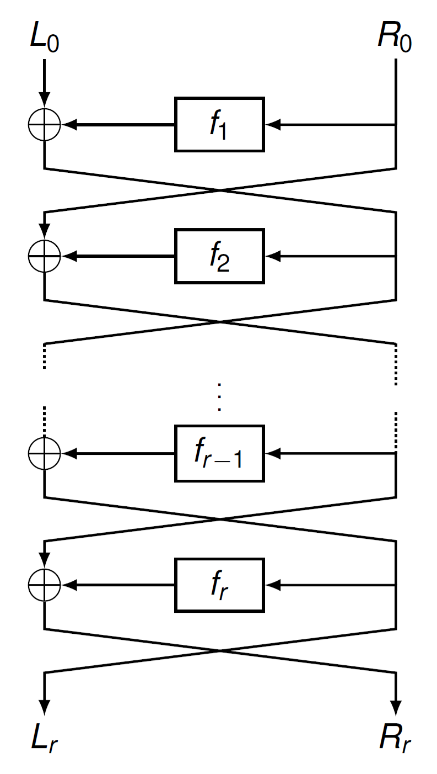
Operation

Slide 9
Properties
Block size
Number of input blocks used
Key size
Length of the encryption key used
Number of rounds
Number of left/right rounding operations used
Subkey generation
Round function

Slide 10
DES

Slide 11
Overview
Was one of the most widely used encryption algorithms around Developed by IBM researchers led by Horst Feistel
Adopted in 1977 by the then National Bureau of Standards (now NIST) as FIPS 46
Designed to be implemented in both hardware and software

Slide 12
DES Features
Block cipher
Uses the Fiestel cipher algorithm
Block size: 64 bits (for both input and output)
Same size for key, but only 56-bits used
What could the other 8 bits be used for?
Number of possible key combination then becomes: 2⁵⁶

Slide 13
Operation
Involves the transformation of plaintext using 16 rounds
Each transformation round features the use of Feistel cipher
64-bit input first broken into two 32-bit chunks
Consists of substitution and permutation operations

Slide 14
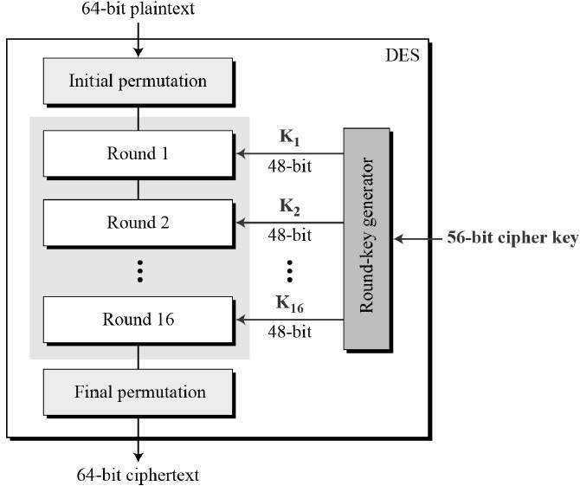
Diagram overview

Slide 15
Initial and Final Permutations
Features the use of permutation boxes (P-Boxes) Designed to achieve Shannon’s Confusion rule
Keyless
Each of the permutations takes a 64-bit input and permutes (changing the order) them according to a predefined rule.

Slide 16
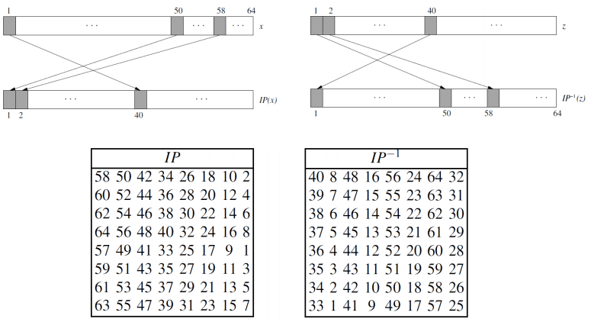
Initial and Final Permutations

Slide 17
Initial and Final Permutations
Initial Permutation
Used right at the beginning of a DES round
Reorders the input data bits
Even bits to the left half, Odd bits to the right
Final Permutation
Used right at the end of a DES round
Switches the left and right halves
Also referred to as “switchers

Slide 18
DES round structure
64-bit input is first divided into two left and right halves of 32-bit:
Feistel cipher is applied on both halves using:
L_{i} = R_{i−1}
Ri = Li− 1 ⊕ F(Ri− 1, Ki )

Slide 19
DES round structure
Each round of DES consists of 3 stages, namely:
Expansion of right half using D-box
Bit substitution using S-boxes
Final permutation using 32-bit permutation matrix P

Slide 20
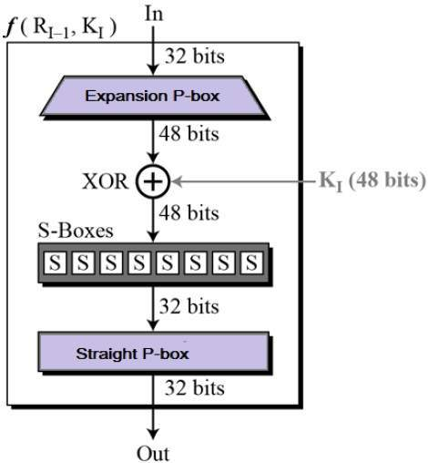
DES Round Breakdown

Slide 21
Bit expansion using D-Box
The right half of the 64-bit input Ri−1 is 32-bit
However, the input key Ki is 48 bit
The expansion of Ri−1 is done using D-Box
XOR operation is then done on the expanded Ri− 1 and Ki , before being passed into S-boxes

Slide 22
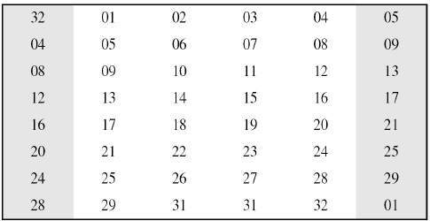
D-Box

Slide 23
Bit substitution using S-boxes
Designed to achieve confusion Involves the use of 8 S-boxes
Each S-box uses a unique table to perform bit substitution
Each S-box accepts 6 input bits and produces 4 outputs
The first and last bits refer to the table row
The middle 4 bits refer to the table column

Slide 24
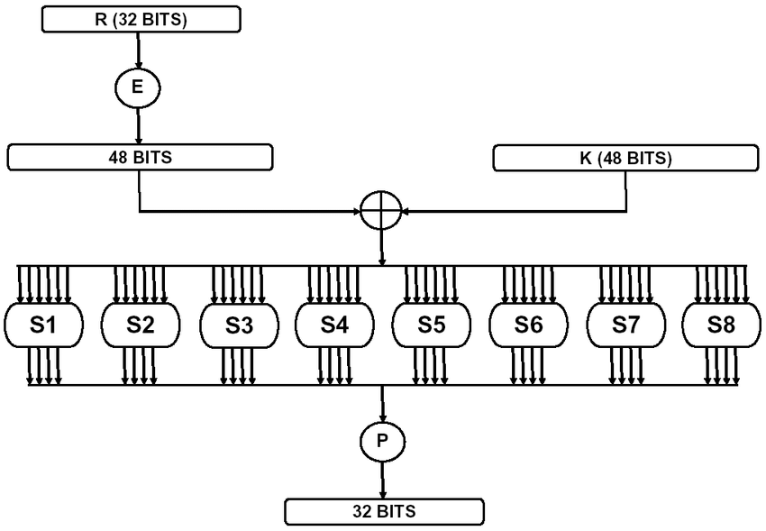
S-boxes

Slide 25
Stage-level permutation
Before passing onto the next round, permutation is performed on the S-box output
It is done using a unique permutation table, similar in principle to the permutation stage at the beginning

Slide 26
Research and find the strengths and weaknesses of DES

Slide 27
Strengths and weaknesses
Strengths | Weaknesses
Avalanche effect | Can officially be brute forced
Use of a 56 bit-key | S-box output can be the same for 2 inputs
Same methods for decryption | Can be predicted using complementary encryption

Slide 28
Recap
Today we looked at symmetric encryption
We also looked at stream and block ciphers
We looked at DES and how it works
Next week: Symmetric encryption II

Slide 29
PSS
Using the paper available on moodle, write a critical review of the different block cipher modes of operation and compare to find which is best in certain scenarios.
Upload your completed work to Moodle before next Thursday

Slide 30
Q&A

